Slide 1
Module 3
3.1 Design Quality, Classification of Design activities. Design concepts: Modularity & Layering. Introduction to Pattern-based software design.
3.2 Software Architecture, Data design, Object -Oriented versus Function - oriented Design, Design of software object, methods, Cohesion & Coupling between objects.
3.3 User Interface design: Rules, User Interface Analysis Steps in Interface design, Design Evaluation
3.4 Software Reuse, Component-based software design

Slide 2
Software Architecture
•Why Architecture?
The architecture is not the operational software.
A representation that enables a software engineer to:
analyze the effectiveness of the design in meeting its stated requirements; Representations of software architecture are an enabler for communication between all parties (stakeholders) interested in the development of a computer-based system.
consider architectural alternatives at a stage when making design changes is still relatively easy,

Slide 3
Software Architecture
The architecture highlights early design decisions that will have a profound impact on all software engineering work that follows and, as important, on the ultimate success of the system as an operational entity.
reduce the risks associated with the construction of the software.
Architecture “constitutes a relatively small, intellectually graspable model of how the system is structured and how its components work together”.

Slide 4
Architectural Styles
Each style describes a system category that encompasses:
a set of components (e.g., a database, computational modules, frameworks) that perform a function required by a system
a set of connectors that enable “communication, coordination and cooperation” among components
constraints that define how components can be integrated to form the system.
semantic models that enable a designer to understand the overall properties of a system by analysing the known properties of its constituent parts. (UML diagrams)

Slide 5
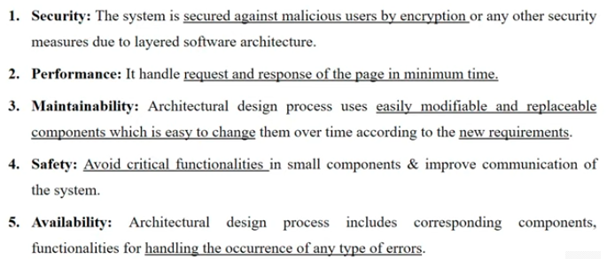
Importance of Software Architecture

Slide 6
Types of Architectural styles
Data - Centred architecture
Data flow architecture
Call and return architecture
Layered architecture

Slide 7
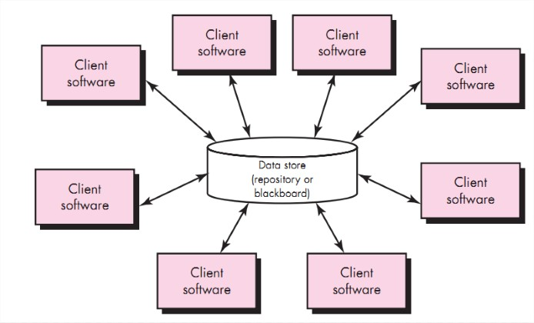
Architectural Styles
1 Data - Centred architecture:
A data store (e.g., a file or database) resides at the centre of this architecture and is accessed frequently by other components.
Client software accesses a central repository.
Data-centred architectures promote integration-ability.
New client components can be added easily.
Client components independently execute processes.
It is widely used in DBMS.
Eg. library management system etc.

Slide 8
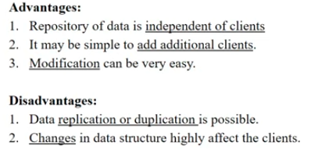

Slide 9
Architectural Styles
2 Data flow architecture:
This architecture is applied when input data are to be transformed through a series of computational or manipulative components into output data.
Pipe and filter pattern.
Pipe is a connector which passes the data directionally from one filter to another.
Filter is a component which reads data from input pipes and perform functions.
Each filter works independently.
If the data flow degenerates into a single line of transforms, it is termed batch sequential.
E.g google search engine

Slide 10
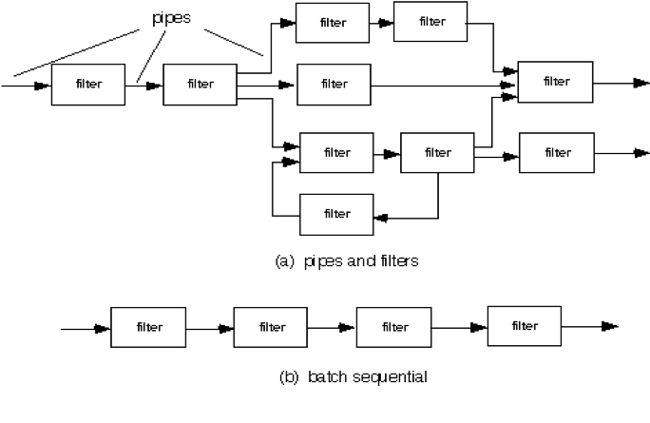
Architectural Styles
2 Data flow architecture:
Advantage:
Supports concurrent execution
Disadvantage:
Don’t allow greater user engagement.
E.g. Result site

Slide 11
Architectural Styles
3. Call and return architecture:
This architectural style enables you to achieve a program structure that is relatively easy to modify and scale.
Sub styles of call and return architecture:
Main program/subprogram architectures: main program invokes a number of program components that in turn may invoke still other components.
Remote procedure call architectures: The components of a main program/subprogram architecture are distributed across multiple computers on a network.

Slide 12
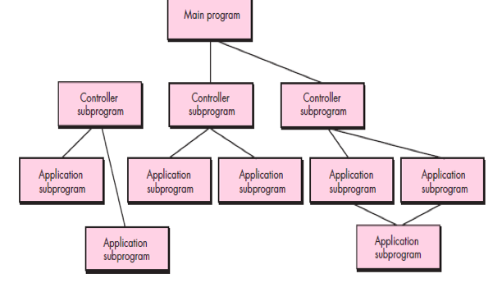
Architectural Styles
3. Call and return architecture:

Slide 13
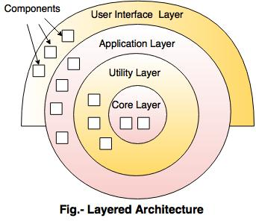

Architectural Styles
4. Layered architecture:
Layered architecture focuses on the grouping of related functionality within an application into distinct layers that are stacked vertically on top of each other.

Slide 14
Output layer:
Component manage the User Interface Operations
Inner layer(core layer):
Component manage the Operating System interfacing. (database)
Intermediate Layer:
Provide utility services and application software functions.

Slide 15
Architectural Design
The software must be placed into context
The design should define the external entities (other systems, devices, people) that the software interacts with and the nature of the interaction
The designer specifies the structure of the system by defining and refining software components that implement each archetype.
Representing the System in Context
At the architectural design level, a software architect uses an architectural context diagram(ACD) to model the manner in which software interacts with entities external to its boundaries.
The generic structure of the architectural context diagram

Slide 16
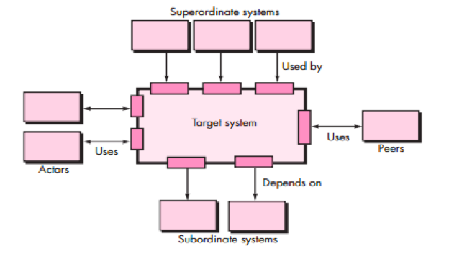
Referring to the fig., systems that interoperate with the target system (the system for which an architectural design is to be developed) are represented as :

Slide 17
Superordinate systems—those systems that use the target system as part of some higher-level processing scheme.
Subordinate systems—those systems that are used by the target system and provide data or processing that are necessary to complete target system functionality.
Peer-level systems—those systems that interact on a peer-to peer basis (i.e., information is either produced or consumed by the peers and the target system.
Actors—entities (people, devices) that interact with the target

Slide 18
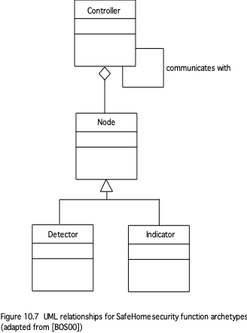
Define Archetype
An archetype is a class or pattern that represents a core abstraction that is critical to the design of an architecture for the target system
In general, a relatively small set of archetypes is required to design even relatively complex systems.
Controller.
component responsible for managing and controlling the behavior of other components or nodes
An abstraction that depicts the mechanism that allows the arming (enable/activate) or disarming of a node.

Slide 19
Node:
Represents a cohesive collection of input and output elements of the home security function.
Nodes can represent physical devices, software processes, or other entities that interact with each other to accomplish a larger task.
For example a node might be comprised of
various sensors and alarm indicators
Detector:
An abstraction that encompasses all sensing equipment that feeds information into the target system.
Indicator.
An abstraction that represents all mechanisms (e.g., alarm siren, flashing lights, bell) for indicating that an alarm condition is occurring.

Slide 20
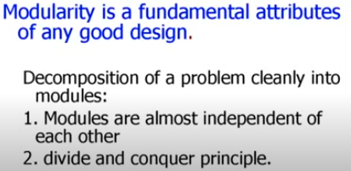
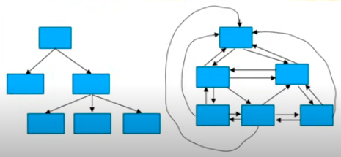
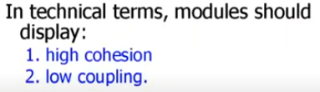
Cohesion and Coupling between Objects
Modularity: decompose functions/methods into modules
Example of cleanly and non-cleanly decomposed modules

Slide 21
Cohesion and Coupling between Objects
Cohesion
implies that a component or class encapsulates only attributes and operations that are closely related to one another and to the class or component itself.
Different types of cohesion
Functional
Based on operations , this level of cohesion occurs when a component performs a targeted computation and then returns a result.
Ex. Event management
Sequential Cohesion:
An element outputs some data that becomes the input for other element, i.e., data flow between the parts. It occurs naturally in functional programming languages.

Slide 22
Communicational.
All operations that access the same data/ data structurre are defined within one class.
Two elements operate on the same input data or contribute towards the same output data.
Example- update record in the database and send it to the printer.
Push and pop in stack.
Procedural Cohesion:
Elements of procedural cohesion ensure the order of execution.
Functions of a module related to each other through a flow control.
Ex- calculate student GPA, print student record, calculate cumulative GPA, print cumulative GPA.
Temporal Cohesion:
The elements are related by their timing involved.
A module connected with temporal cohesion all the tasks must be executed in the same time span.

Slide 23
Logical Cohesion:
The elements are logically related and not functionally.
All the code for these functions is in the same component.
Operations are related, but the functions are significantly different.
Ex- mouse, printer, scanner
Coincidental Cohesion:
The elements are not related(unrelated). It is accidental and the worst form of cohesion.
Ex- print next line and reverse the characters of a string in a single component.

Slide 24
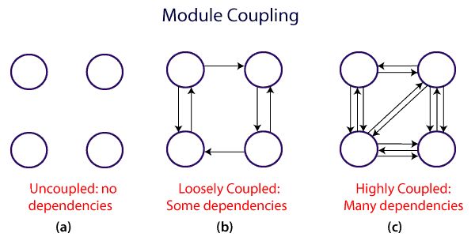
Coupling
Coupling
a qualitative measure of the degree to which classes are connected to one another.

Slide 25
Architectural Design
Different types of coupling
1. Data coupling –
when two modules communicate with each other only by passing data.
Occurs when operations pass long strings of data arguments.
Band width of communication increases complexity increases maintenance becomes difficult.
2. Stamp coupling –
when two modules communicate with each other by passing of data structure. (call by reference)
Occurs when systems operation are in nested state , modifying the system becomes complex.
Similar to common coupling but here global data is accessible to
selected routines.

Slide 26
Architectural Design
Control coupling – Occurs when one operation controls flow of another operation and control signals are sent. Changes done to an operation are to be monitored for errors. (Ex. Wasing machine operations)(send and acknowledge)
External coupling - Occurs when a component communicates or collaborates with infrastructure components (e.g., operating system functions, database capability, telecommunication functions).
Ex. payment gateway (Module B) to process transactions.
This type of coupling is necessary but it should also be limited
Common coupling Occurs when a number of components all make use of a global variable. Common coupling can lead to error propagation.
Content coupling Occurs when one component secretly modifies data that is internal to another component (friend function /class)
when one module is a part of another module. High level dependency. (e.g. car and engine- engine is the part of car)

Slide 27
Architectural Design
Routine call coupling - Occurs when one operation invokes another
Type use coupling. Occurs when component A uses a data type defined in component B.
If the type definition changes, every component that uses the definition must also change.
Inclusion or import coupling. Occurs when component A imports or includes a package or the content of component B.
.

Slide 28
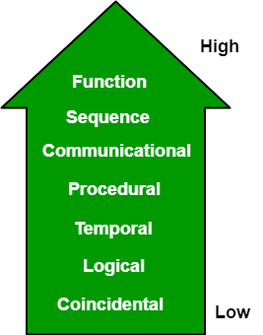
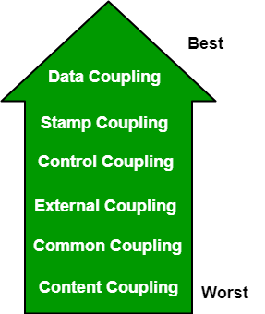
Comparison
Best
Worst

Slide 29
Module 3
3.1 Design Quality, Classification of Design activities. Design concepts: Modularity & Layering. Introduction to Pattern-based software design.
3.2 Software Architecture, Data design, Object -Oriented versus Function - oriented Design, Design of software object, methods, Cohesion & Coupling between objects.
3.3 User Interface design: Rules, User Interface Analysis Steps in Interface design, Design Evaluation
3.4 Software Reuse, Component-based software design

Slide 30
UI/UX design
UI/UX design refers to the fields of User Interface (UI) and User Experience (UX) design, which are crucial for creating effective, engaging, and user-friendly digital products such as websites, apps, and software.
UI Design (User Interface Design)
Focus: UI design focuses on the look and feel of a product. It deals with the design of the graphical layout of an application, including buttons, icons, spacing, typography, color schemes, and responsive design.
UX Design (User Experience Design)
Focus: UX design focuses on the overall experience a user has when interacting with a product. It involves understanding the users’ needs, behavior, and emotions to create a product that provides a meaningful and relevant experience.

Slide 31
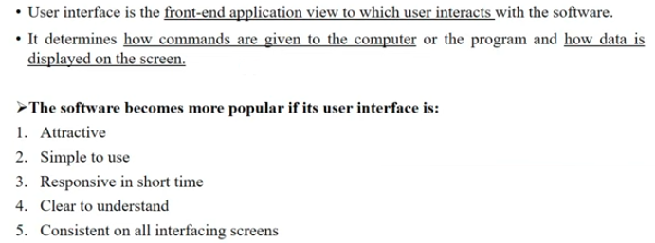
User Interface Design

Slide 32
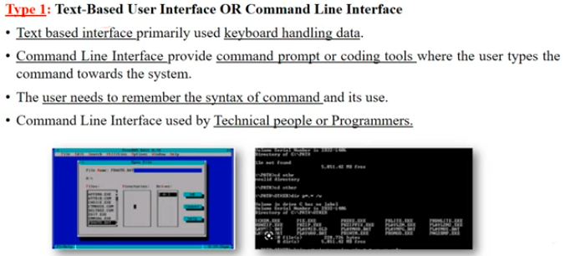
Types of user interface

Slide 33
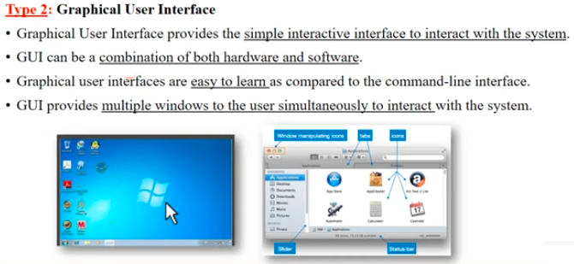

Slide 34
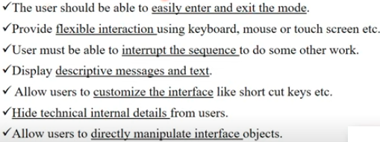
User Interface Design Rules
Place user in control
A system or user interface should be designed keeping user in mind.
Interface designed should be easy to use and build.

Slide 35
User Interface Design
Design principles that allow the user to maintain control:
Define interaction modes in a way that does not force a user into unnecessary or undesired actions.
Example: Spell Checking mode
Provide for flexible interaction. Because different users have different interaction preferences, choices should be provided.
Example: software might allow a user to interact via keyboard commands, mouse movement, a digitizer pen etc.
Allow user interaction to be interruptible and undoable.
Ex: user can perform interrupt the sequence to do another work.
Hide technical internals from the casual user.
Example: In a file management application, users typically interact with a GUI where they can drag and drop files into folders. The application handles all the technical details, such as file paths and system permissions, in the background.
Design for direct interaction with objects that appear on the screen.

Slide 36
User Interface Design Rules
2. Reduce the users’ memory load:
The more a user has to remember, the more error-prone the interaction with the system will be.
well-designed user interface does not burdon the user’s memory
It focuses on minimizing the amount of information users need to remember when interacting with a product.
design an interface that to reduce the users’ memory load:
Reduce demand on short-term memory – complex tasks demand on short term memory is high - interface designed to reduce dependency.
Establish meaningful defaults - “reset” option should be available for enabling original default values.
Defines short cuts that are more intuitive (easy to remember)
Ctrl- s, Ctrl-p , alt-p

Slide 37
User Interface Design Rules
Reduce the users’ memory load:
Consistent Design Patterns: Use familiar design patterns and elements across the interface.
For example, if a user learns how to use one part of an app, they should be able to apply that knowledge to other parts of the app without needing to learn new patterns.
Standard Icons and Labels: Use standard icons (like a magnifying glass for search or a gear icon for settings) and labels that users are likely to recognize.
Visible Information:
Display Relevant Information: Keep essential information visible on the screen rather than requiring users to remember it.
For example, showing a shopping cart icon with the number of items currently in the cart prevents users from having to remember what they added.
Tooltips and Hints: Provide tooltips, hints, or inline help that appear when users hover over or focus on elements.
Disclose information in a progressive fashion –
The interface should be organized hierarchically.
An example, word-processing applications

Slide 38
Clear Navigation and Structure:
Breadcrumbs: Use breadcrumb navigation to show users their current location within the interface and how they got there, which helps them understand context without having to remember it.
Progress Indicators: In multi-step processes (like a checkout flow), show progress indicators so users know where they are in the process and what steps remain.
Recognition Over Recall:
Recognition-Based Interfaces: Design interfaces where users can recognize options rather than recall information.
For instance, using dropdown menus or lists of choices instead of requiring users to remember and type in information.
Predictive Text and Autocomplete: Features like autocomplete in search bars or predictive text suggestions help users by reducing the amount of information they need to remember and enter manually.

Slide 39
User Interface Design Rules
3. Make the interface consistent:
“Things that look different should act different. Things that look the same should act the same”, across the entire product.
Allow the user to put the current task into a meaningful context.
Complex layers to be implemented with clear indication to the user about the context of the work at hand.
If past interactive models have created user expectations, do not make changes unless there is a compelling reason to do so.

Slide 40
Maintain consistency across a family of applications.
A set of applications (or products) should all implement the same design rules - consistency is maintained for all interaction.
Consistency in an interface means that similar elements behave and appear in the same way across the entire product.
This uniformity helps users learn how to interact with the interface quickly, reduces confusion, and enhances the overall user experience.
Types of Consistency in UI Design:
Visual Consistency:
Consistent Design Elements: Use the same fonts, colors, icons, and button styles throughout the application.
For example, if your primary action button is always blue and rounded, it should appear that way on every screen or page.
Functional Consistency:
Consistent Behavior:
Similar actions should have similar results across the interface.
For example, if a swipe gesture deletes an item in one part of the app, the same gesture should perform the same action elsewhere.

Slide 41
Internal Consistency:
Consistency Within the Product: Ensure that the design patterns, terminology, and interaction styles are uniform across different parts of the same product.
Example: In an e-commerce website, if the "Add to Cart" button is always located at the bottom right of product pages, users will expect it to be there every time they view a product.

Slide 42
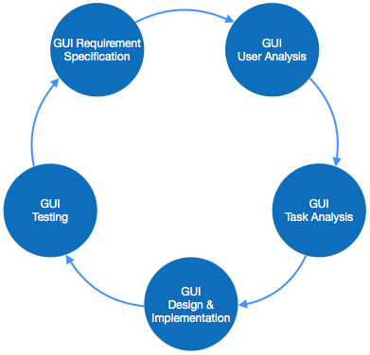
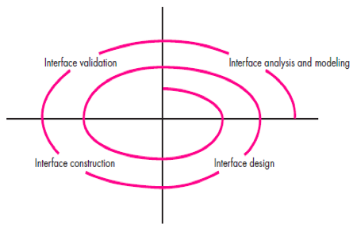
User Interface Design Activities/ Process
There are a number of activities performed for designing user interface. The process of GUI design and implementation is alike SDLC.
Any model can be used for GUI implementation among Waterfall, Iterative or Spiral Model.
Iterative, Incremental

Slide 43
User Interface Design Process
(1) Interface analysis – focuses on the profile of the users who will interact with the system. Different user categories are defined.
•Once general requirements have been defined, a more detailed task analysis is conducted.
-User analysis
-Task analysis
(2) Interface design – is to define a set of interface objects and actions that enable a user to perform all defined tasks to meet goals defined.
(3) Interface construction - normally begins with the creation of a prototype that enables usage scenarios to be evaluated.
(4) Interface validation - focuses on
a)the ability of the interface to implement every user task correctly, accommodate all task variations, and to achieve all general user requirements;
b)the degree to which the interface is easy to use and easy to learn
c)the users’ acceptance of the interface as a useful tool in their work

Slide 44
Interface Analysis
Understand the problem before you attempt to design a solution.
The people (end users) who will interact with the system through the interface.
The tasks that end users must perform to do their work,
The content that is presented as part of the interface
The environment in which these tasks will be conducted

Slide 45
Interface Analysis Steps
User Analysis
User interviews
Sales Input: Sales people meet with users on a regular basis and can gather information.
Marketing input.
Support input - Support staff talks with users on a daily basis.

Slide 46
Interface Analysis Steps
2. Task Analysis & Modelling
Gather information about the tasks and subtasks performed by the user, their workflow and hierarchy
Use cases.
Task elaboration - stepwise elaboration (also called functional decomposition or stepwise refinement) for software to accomplish some desired function.
Object elaboration: Examine use case and other information obtained from the user.
Workflow analysis - When a number of different users, makes use of a user interface workflow analysis becomes important.
E.g: verification process
Hierarchical representation - Once workflow has been established, a task hierarchy can be defined for each user type.
Ex. Top level tasks-> sub tasks

Slide 47
Interface Analysis Steps
3. Analysis of Display Content –
The presentation of a variety of different types of content.
•For modern applications, display content can range from character-based reports (e.g., a spreadsheet),
graphical displays (e.g., a histogram, a 3-D model, a picture of a person),
or specialized information (e.g., audio or video files).

Slide 48
Interface Design Steps
4. Analysis of the Work Environment
Using information developed during interface analysis, define interface objects and actions (operations).
Define events (user actions) that will cause the state of the user interface to change. Model this behavior.
Depict each interface state as it will actually look to the end-user.
Indicate how the user interprets the state of the system from information provided through the interface.

Slide 49
Design issues
1. Response Time
This refers to how quickly the system reacts to user inputs or requests. A good software system provides prompt responses to user actions. Slow response times can frustrate users, while fast response times improve user experience.
Example: In an e-commerce application, when a user clicks on "Add to Cart," the system should respond immediately by updating the cart and showing the item has been added. If it takes more than a few seconds, the user might get frustrated and abandon the site.
2. Help Facilities
Help facilities guide users when they encounter difficulties or are unsure of how to use certain features. This can include tooltips, FAQs, documentation, and live support.
Example: In Microsoft Word, if a user is confused about how to insert a table, they can click on the help icon to access step-by-step instructions or search for help topics related to inserting tables.
3. Error Handling
Error handling is crucial for making sure that the software can handle unexpected situations gracefully and guide the user through correction.
Example: In a banking application, if a user enters the wrong format for their credit card number, the system should display a clear message like “Invalid card number, please enter a 16-digit number” rather than crashing or providing a generic error message like “Error occurred.”

Slide 50
4. Menu and Command Labeling
Menus and commands should be labeled in a way that makes it easy for users to understand their function. They should be intuitive, concise, and meaningful.
Example: In an online photo editor, instead of labeling a button “Adjust Image Properties,” a more intuitive label like “Edit Photo” might be better because it directly describes the action in plain language.
5. Application Accessibility for Physically Challenged Users
Software design should include features that make the application usable for people with physical disabilities, such as those with visual, auditory, or motor impairments. This can include support for screen readers, keyboard navigation, and voice commands.
Example: Windows OS includes narrator functionality for visually impaired users, which reads out screen text and descriptions. It also allows for keyboard-only navigation for users who cannot use a mouse.
6. Internationalization
This involves designing software so that it can be easily adapted for various languages and regions without major changes to the underlying code. It ensures that the software can be used in different cultural and linguistic settings.
Example: Google Search is available in multiple languages. The interface changes based on the region, with support for different character sets, right-to-left text (for Arabic, Hebrew), and localized formats for dates and numbers.

Slide 51
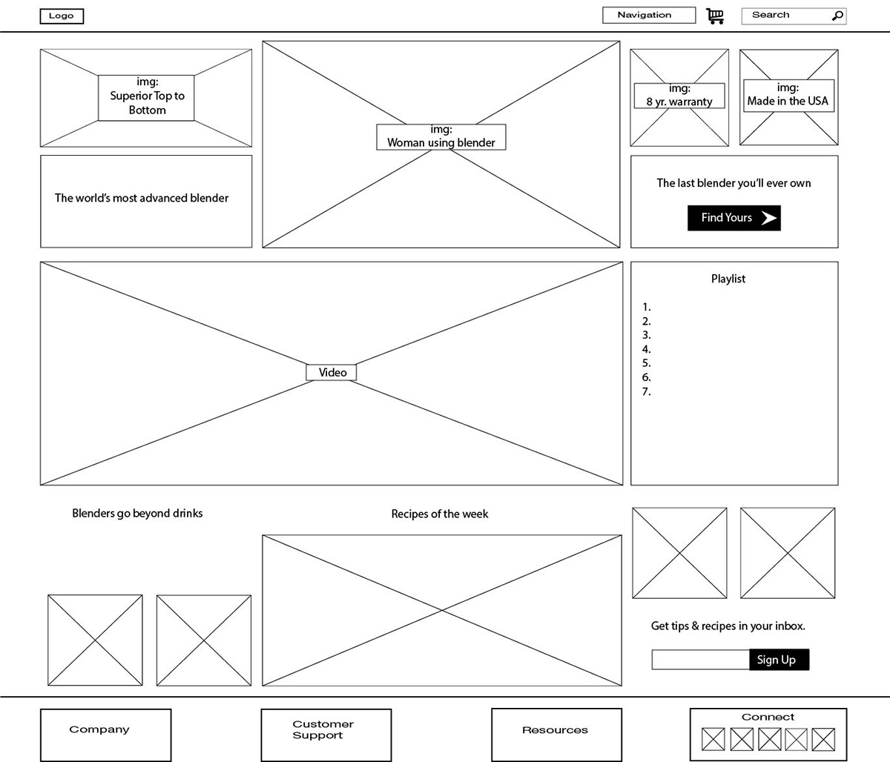
Example - Wireframe design of Online Shopping cart

Slide 52
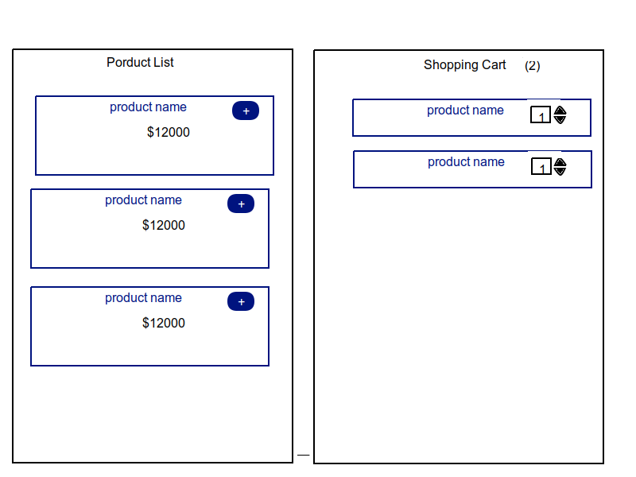

Slide 53
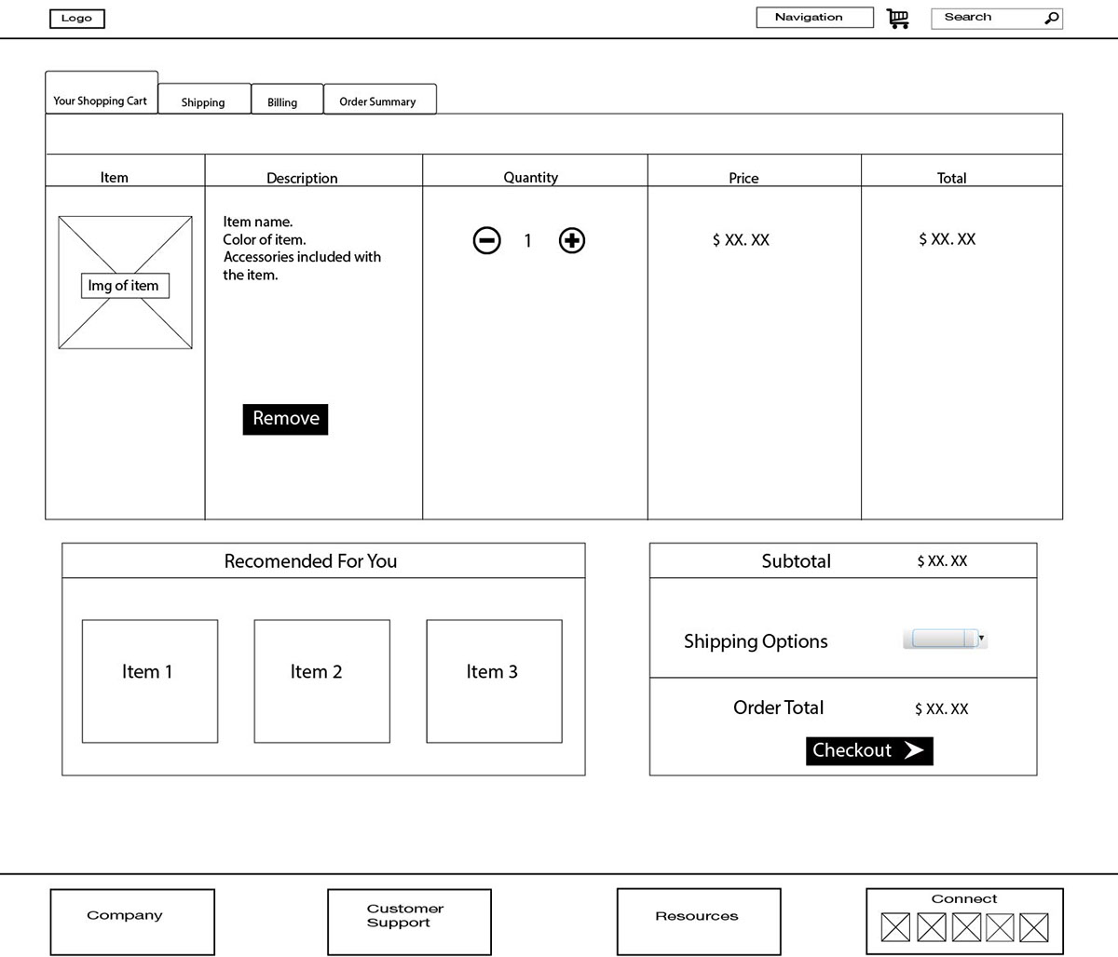

Slide 54
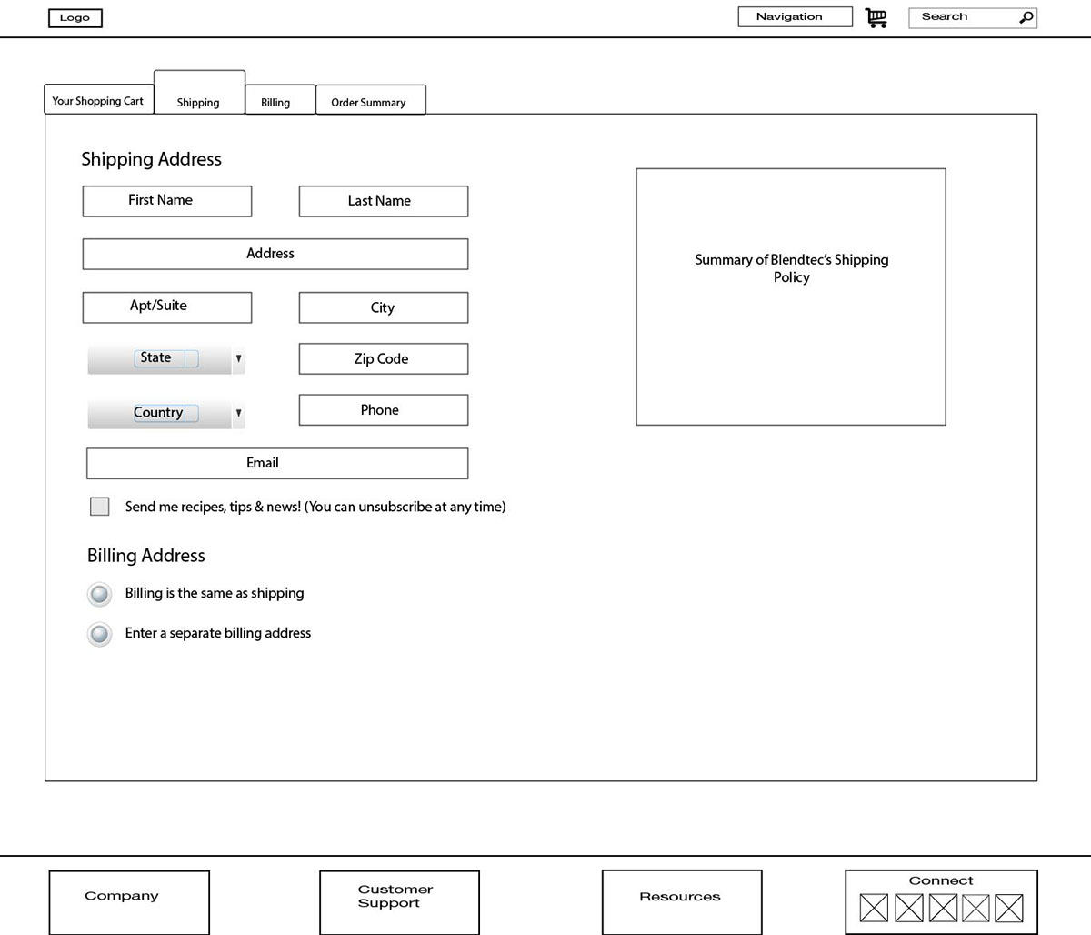

Slide 55
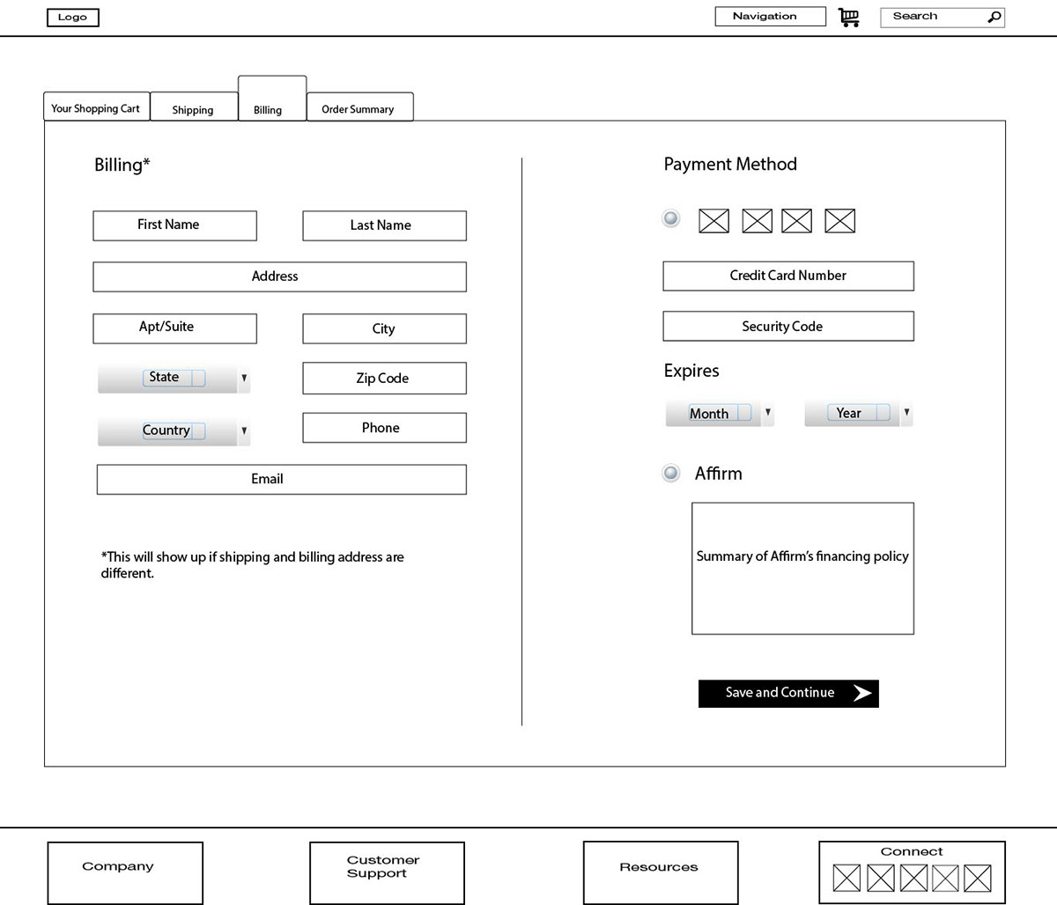

Slide 56
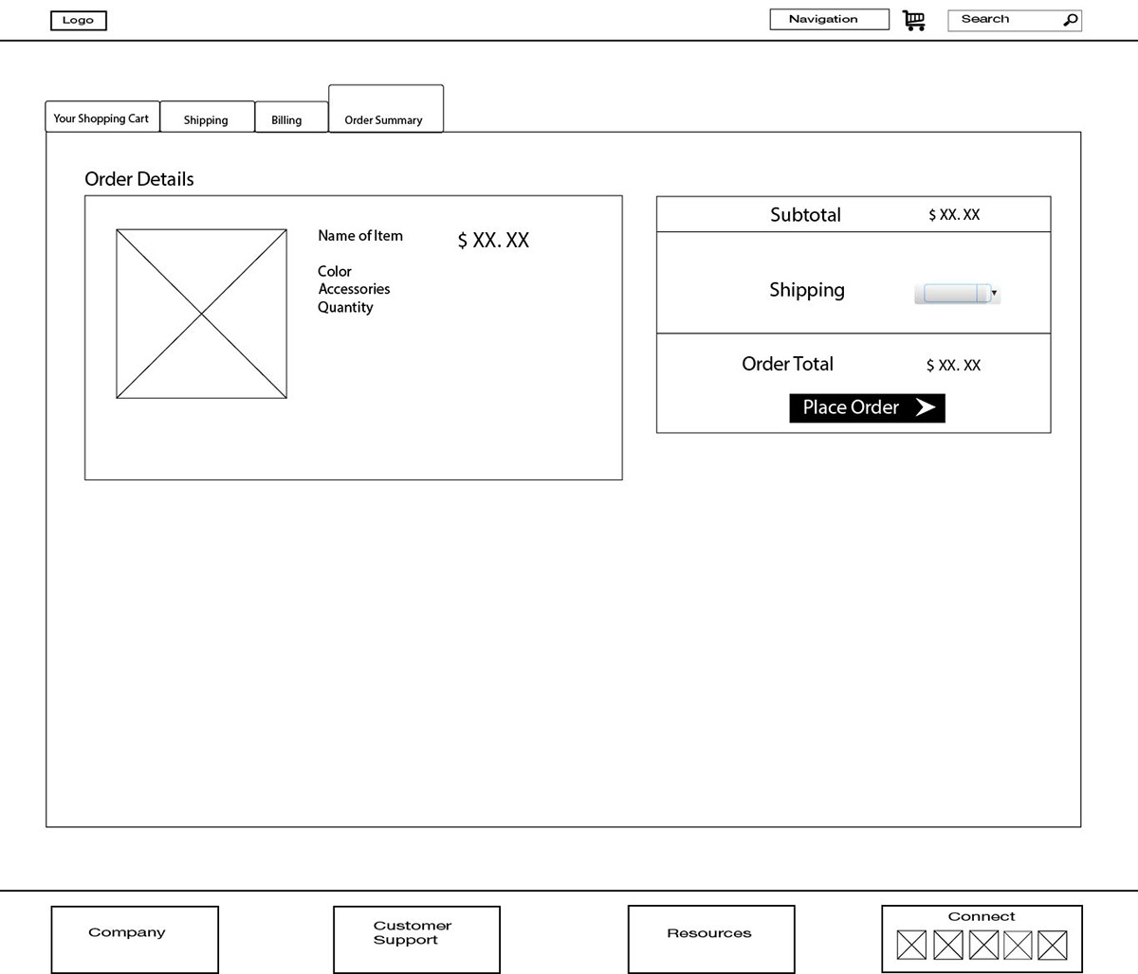

Slide 57
Module 3
3.1 Design Quality, Classification of Design activities. Design concepts: Modularity & Layering. Introduction to Pattern-based software design.
3.2 Software Architecture, Data design, Object -Oriented versus Function - oriented Design, Design of software object, methods, Cohesion & Coupling between objects.
3.3 User Interface design: Rules, User Interface Analysis Steps in Interface design, Design Evaluation
3.4 Software Reuse, Component-based software design

Slide 58
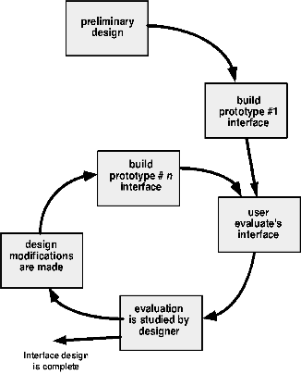
Design Evaluation Cycle

Slide 59
Design with Reuse
Building software with reusable components
Software design with reuse is the practice of using existing software components software artifacts, such as code, libraries, frameworks, or design patterns to build new software.
to achieve better software, more quickly and at lower cost, adopt a design process that is based on systematic reuse.
Software reuse can reduce development time and cost, increase reliability and performance, and promote consistency and standardization

Slide 60
Reuse based Software Engineering
Application system reuse
The whole of an application system may be reused either by incorporating it without change into other systems or by configuring the application for different customers.
Application families that have a common architecture, but which are tailored for specific customers, may be developed.
Example: Using a pre-built e-commerce platform like Shopify
Component reuse
Components of an application from sub-systems to single objects may be reused
Example: Reusing a login module across multiple web applications
Object and Function reuse
Software components that implement a single function, such as a mathematical function, or an object class may be reused
Example: Using a pre-defined function for calculating taxes in a financial application

Slide 61
Benefits of Reuse
Increased reliability
Components exercised in working systems
Reduced process risk
Less uncertainty in development costs
Effective use of specialists
Reuse components instead of people
Standards compliance
Embed standards in reusable components
Accelerated development
Avoid original development and hence speed-up production

Slide 62
Components Based Software Engineering (CBSE)
It is an approach to software development that focuses on building systems by assembling reusable, independent components.
Approach to software development that relies on reuse
It emerged from the failure of object-oriented development to support effective reuse. Single object classes are too detailed and specific
Components are more abstract than object classes and can be considered to be stand-alone service providers.
Components can range in size from simple functions to entire application systems

Slide 63
Key goals of CBSE
Save time and money when building large and complex systems
Enhance the software quality
Detect defects within the systems
Improved efficiency
Minimized delivery

Slide 64
Key concepts in CBSE
Components:
A software component is a self-contained unit of functionality with clearly defined interfaces.
Components are designed to be reused in different applications or systems.
They encapsulate their functionality and are often distributed as binary units (e.g., libraries, modules, or services).
Reuse:
CBSE aims to maximize reuse of components, both at the internal and external levels (e.g., third-party components).
Instead of writing code for common functionalities, developers can reuse existing components, saving time and effort.
Interfaces:
Each component has a well-defined interface that specifies how other components or systems interact with it.
Components typically have:
Provides Interface: Defines the services or functionalities the component offers.
Requires Interface: Defines the services or dependencies that the component needs to operate.

Slide 65
Interoperability:
CBSE focuses on ensuring that components can interoperate and work together seamlessly, even if they come from different sources.
Composition:
In CBSE, software systems are built through composition—assembling different components together.
The composition can be achieved using design tools or frameworks that manage the integration and interaction of components.
Independence and Loose Coupling:
Components are designed to be independent and loosely coupled, meaning they can function with minimal dependency on other components.
This independence enhances flexibility, as components can be easily replaced or upgraded without affecting the entire system.
Customization and Extensibility:
Components may allow some degree of customization (e.g., configuration options) so they can be adapted to different use cases.
They can also be extended to provide additional features when needed.

Slide 66
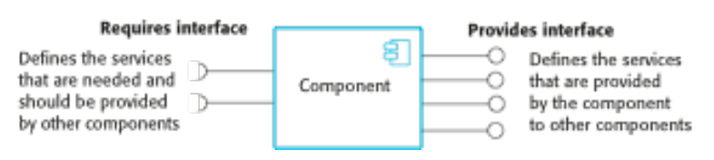
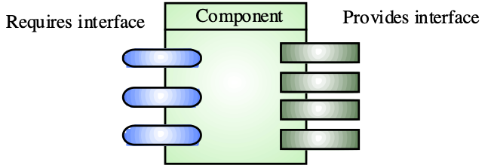
Component Interfaces
These interfaces reflect the services that the component provides and the services that the component requires to operate correctly
Provides interface
Defines the services that are provided by the component to other components or parts of the system.
Requires interface
Defines the services that specifies what services must be made available for the component to execute as specified

Slide 67
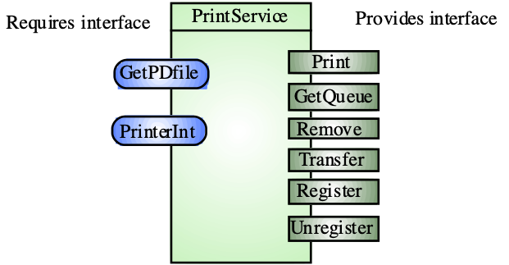
Example: Printing service Component

Slide 68
CBSE Process
CBSE processes are software processes that support component-based software engineering.
They take into account the possibilities of reuse and the different process activities involved in developing and using reusable components.
Development for reuse
This process is concerned with developing components or services that will be reused in other applications.
It usually involves generalizing existing components
Focus: Creating software components or systems that are designed to be reused across multiple projects or contexts.
Objective: The goal is to build general-purpose components, modules, or libraries that are flexible, modular, and adaptable to a wide range of use cases.
Example: A team develops a reusable authentication module that can be used in multiple applications, such as web apps, mobile apps, and enterprise systems.

Slide 69
2. Development with reuse
This is the process of developing new applications using existing components and services.
Focus: Building software by reusing existing components that have already been developed either in-house or sourced externally.
Objective: The goal is to accelerate development by leveraging pre-built modules, libraries, frameworks, or even entire systems to avoid reinventing the wheel.
Example: A developer building a web application uses the Django web framework to handle routing, authentication, and database interactions instead of developing these features from scratch. They may also reuse third-party libraries for specific features like payment processing or image uploads

Slide 70
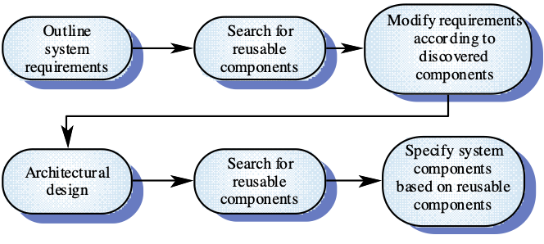
CBSE for reuse
CBSE for reuse is the process of developing reusable components and making them available for reuse through a component management system.

Slide 71
CBSE with reuse
When reusing components, it is essential to make tradeoffs between ideal requirements and the services actually provided by available components.
This involves:
§ Developing outline requirements;
§ Searching for components then modifying requirements according to available functionality.
§ Searching again to find if there are better components that meet the revised requirements.
§ Composing components to create the system.

Slide 72

The component identification process

Slide 73
Component identification issues
Trust.
You need to be able to trust the supplier of a component.
At best, an untrusted component may not operate as advertised; at worst, it can breach your security.
Requirements.
Different groups of components will satisfy different requirements.
Validation.
The component specification may not be detailed enough to allow comprehensive tests to be developed. Components may have unwanted functionality.
How can you test this will not interfere with your application?
Component validation involves developing a set of test cases for a component (or, possibly, extending test cases supplied with that component) and developing a test harness to run component tests.
The major problem with component validation is that the component specification may not be sufficiently detailed to allow you to develop a complete set of component tests.

Slide 74
Object-Oriented versus Function-Oriented Design

